Slide 1
Software Design patterns
Presentation by Anchal Gupta

Slide 2
Creational Patterns
These design patterns provide a way to create objects while hiding the creation logic, rather than instantiating objects directly using new operator. This gives program more flexibility in deciding which objects need to be created for a given use case.

Slide 3
Types of creational design patterns
Some of the types of creational design pattern are
Singleton
Factory
Abstract Factory
Builder
Prototype

Slide 4
Singleton Design Pattern
The singleton pattern is a software design pattern that restricts the instantiation of a class to one object. This is useful when exactly one object is needed to coordinate actions across the system. The concept is sometimes generalized to systems that operate more efficiently when only one object exists, or that restrict the instantiation to a certain number of objects. The term comes from the mathematical concept of a singleton.
An implementation of the singleton pattern must:
ensure that only one instance of the singleton class ever exists; and
provide global access to that instance.
Typically, this is done by:
declaring all constructors of the class to be private; and
providing a static method that returns a reference to the instance.

Slide 5
Code
Java
public final class Singleton { private static volatile Singleton instance = null; private Singleton() {} public static Singleton getInstance() { if (instance == null) { synchronized(Singleton.class) { if (instance == null) { instance = new Singleton(); } } } return instance; } }

Slide 6
Factory Method Pattern
Factory methods to deal with the problem of creating objects without having to specify the exact class of the object that will be created.
This is done by creating objects by calling a factory method—either specified in an interface and implemented by child classes, or implemented in a base class and optionally overridden by derived classes—rather than by calling a constructor.

Slide 7
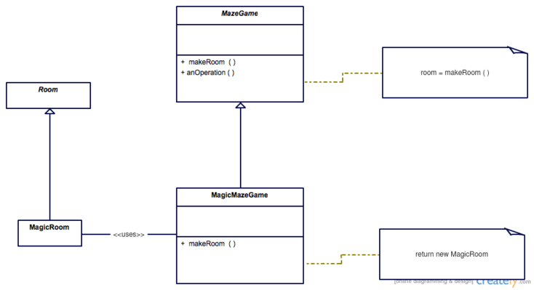
Structure

Slide 8
Example implementations
Java
A maze game may be played in two modes, one with regular rooms that are only connected with adjacent rooms, and one with magic rooms that allow players to be transported at random (this Java example is similar to one in the book Design Patterns). The MazeGame uses Rooms but it puts the responsibility of creating Rooms to its subclasses which create the concrete classes. The regular game mode could use this template method:
public abstract class MazeGame { private final List<Room> rooms = new ArrayList<>(); public MazeGame() { Room room1 = makeRoom(); Room room2 = makeRoom(); room1.connect(room2); rooms.add(room1); rooms.add(room2); } abstract protected Room makeRoom(); }
In the previous snippet, the MazeGame constructor is a template method that makes some common logic. It refers to the makeRoomfactory method that encapsulates the creation of rooms such that other rooms can be used in a subclass. To implement the other game mode that has magic rooms, it suffices to override the makeRoom method:
public class MagicMazeGame extends MazeGame { @Override protected Room makeRoom() { return new MagicRoom(); } } public class OrdinaryMazeGame extends MazeGame { @Override protected Room makeRoom() { return new OrdinaryRoom(); } } MazeGame ordinaryGame = new OrdinaryMazeGame(); MazeGame magicGame = new MagicMazeGame();

Slide 9
Abstract Factory Pattern
The abstract factory pattern provides a way to encapsulate a group of individual factories that have a common theme without specifying their concrete classes.^{[1]} In normal usage, the client software creates a concrete implementation of the abstract factory and then uses the generic interface of the factory to create the concrete objects that are part of the theme.
A factory is the location of a concrete class in the code at which objects are constructed.
The factory determines the actual concrete type of object to be created, and it is here that the object is actually created (in C++, for instance, by the new operator). However, the factory only returns an abstract pointer to the created concrete object.
This insulates client code from object creation by having clients ask a factory object to create an object of the desired abstract type and to return an abstract pointer to the object.^{[4]}

Slide 10
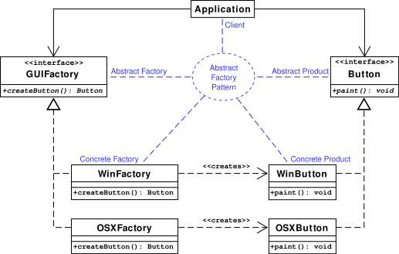
Class diagram

Slide 11
Pseudocode
It should render a button in either a Windows style or Mac OS X style depending on which kind of factory was used. Note that the Application has no idea what kind of GUIFactory it is given or even what kind of Button that factory creates.
interface Button is method paint() interface GUIFactory is method createButton() output: a button class WinFactory implementing GUIFactory is method createButton() is output: a Windows button Return a new WinButton class OSXFactory implementing GUIFactory is method createButton() is output: an OS X button Return a new OSXButton
class WinButton implementing Button is method paint() is Render a button in a Windows style class OSXButton implementing Button is method paint() is Render a button in a Mac OS X style class Application is constructor Application(factory) is input: the GUIFactory factory used to create buttons Button button := factory.createButton() button.paint() Read the configuration file If the OS specified in the configuration file is Windows, then Construct a WinFactory Construct an Application with WinFactory else Construct an OSXFactory Construct an Application with OSXFactory

Slide 12
Builder pattern
The purpose of the builder pattern is to find a solution to the telescoping constructor anti-pattern. The telescoping constructor anti-pattern occurs when the increase of object constructor parameter combination leads to an exponential list of constructors. Instead of using numerous constructors, the builder pattern uses another object, a builder, that receives each initialization parameter step by step and then returns the resulting constructed object at once.
Advantages
Allows you to vary a product’s internal representation.
Encapsulates code for construction and representation.
Provides control over steps of construction process.
Disadvantages
Requires creating a separate ConcreteBuilder for each different type of Product.

Slide 13
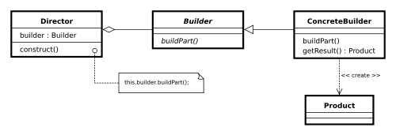
Structure

Slide 14
Pseudocode
We have a Car class. The problem is that a car has many options. The combination of each option would lead to a huge list of constructors for this class. So we will create a builder class, CarBuilder. We will send to the CarBuilder each car option step by step and then construct the final car with the right options:
class Car is Can have GPS, trip computer and various numbers of seats. Can be a city car, a sports car, or a cabriolet. class CarBuilder is method getResult() is output: a Car with the right options
Construct and return the car. method setSeats(number) is input: the number of seats the car may have. Tell the builder the number of seats. method setCityCar() is Make the builder remember that the car is a city car. method setCabriolet() is Make the builder remember that the car is a cabriolet.
method setSportsCar() is Make the builder remember that the car is a sports car. method setTripComputer() is Make the builder remember that the car has a trip computer. method unsetTripComputer() is Make the builder remember that the car does not have a trip computer. method setGPS() is Make the builder remember that the car has a global positioning system. method unsetGPS() is Make the builder remember that the car does not have a global positioning system.
Construct a CarBuilder called carBuilder carBuilder.setSeats(2) carBuilder.setSportsCar() carBuilder.setTripComputer() carBuilder.unsetGPS() car := carBuilder.getResult()

Slide 15
Prototype pattern
The prototype pattern is a creational design pattern in software development. It is used when the type of objects to create is determined by a prototypical instance, which is cloned to produce new objects. This pattern is used to:
avoid subclasses of an object creator in the client application, like the abstract factory pattern does.
avoid the inherent cost of creating a new object in the standard way (e.g., using the 'new' keyword) when it is prohibitively expensive for a given application.
Implementation
To implement the pattern, declare an abstract base class that specifies a pure virtual clone() method. Any class that needs a "polymorphic constructor" capability derives itself from the abstract base class, and implements the clone() operation.
The client, instead of writing code that invokes the "new" operator on a hard-coded class name, calls the clone() method on the prototype, calls a factory method with a parameter designating the particular concrete derived class desired, or invokes the clone() method through some mechanism provided by another design pattern.

Slide 16
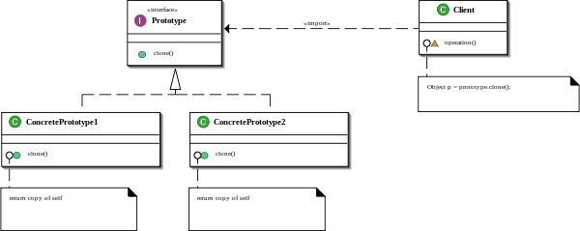
Structure

Slide 17
Example
Java
This pattern creates the kind of object using its prototype. In other words, while creating the object of Prototype object, the class actually creates a clone of it and returns it as prototype. You can see here, we have used Clone method to clone the prototype when required.
// Prototype pattern public abstract class Prototype implements Cloneable { public Prototype clone() throws CloneNotSupportedException{ return (Prototype) super.clone(); } } public class ConcretePrototype1 extends Prototype { @Override public Prototype clone() throws CloneNotSupportedException { return super.clone(); } } public class ConcretePrototype2 extends Prototype { @Override public Prototype clone() throws CloneNotSupportedException { return super.clone(); } }

